Slide 1
Lecture 3
PROJECT
Time Management

Slide 2
Project TIME management
Project Time Management includes the processes required to accomplish timely completion of the project
Part of Triple Constraints
Managers often cite delivering projects on time as one of their biggest challenges
Schedule issues are the main reason for conflicts on projects, especially during the second half of projects
Notes:
Chapter 5
PROJECT SCOPE MANAGEMENT
Project Scope Management includes the processes required to ensure that the project includes all the work required, and only the work required, to complete the project successfully.
Managing the project scope is primarily concerned with defining and controlling what is and is not included in the project.

Slide 3
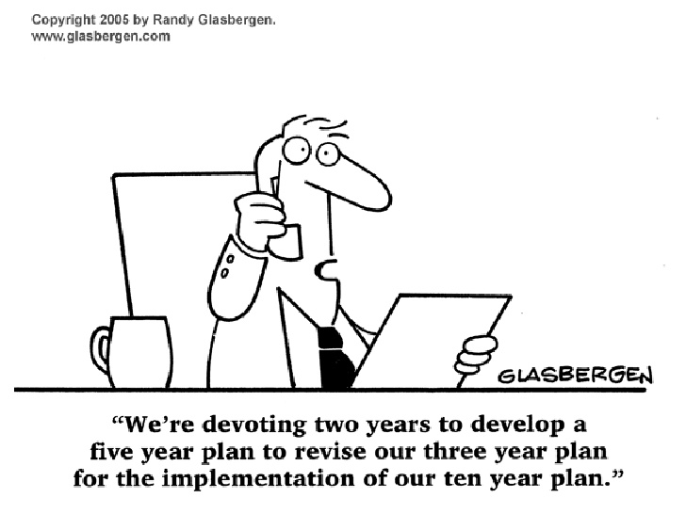

Slide 4
PROJECT TIME MANAGEMENT
An activity or task is an element of work normally found on the WBS that has an expected duration, a cost, and resource requirements
Project schedules grow out of the basic documents that initiate a project
The project charter includes start and end dates and budget information
The scope statement and WBS help define what will be done
Activity definition involves developing a more detailed WBS and supporting explanations to understand all the work to be done, so you can develop realistic cost and duration estimates

Slide 5
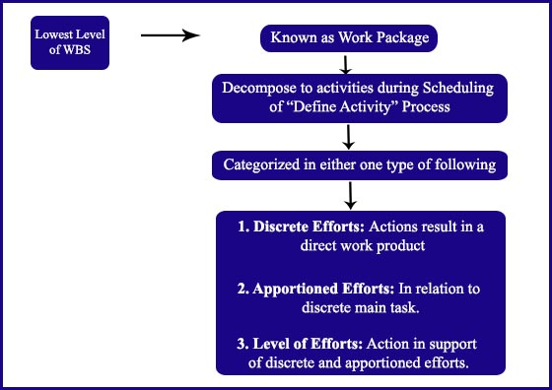
Types of Activities
Planned work is contained in the lower level of WBS known as Work package and during scheduling these work packages are further decompose to activities.
These activities are categorized in one of the following:
Discrete Efforts
Level of Efforts
Apportioned Efforts

Slide 6
PROJECT TIME MANAGEMENT
Plan Schedule Management
Define Activities
Sequence Activities
Estimate Activity Resources
Estimate Activity Duration
Develop Schedule
Control Schedule
Define
Activities
Sequence
Activities
Estimate Activity Resources
Estimate Activity Durations
Develop
Schedule
Control Schedule

Slide 7
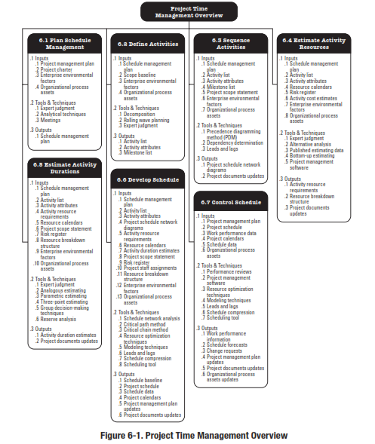
Reference: Figure 6.2.
PMBOK® Guide, 5^{h} Ed

Slide 8
PROJECT TIME MANAGEMENT
Plan Schedule Management – The process of establishing the policies, procedures, and documentation for planning, developing, managing, executing, and controlling the project schedule.
Define Activities – The process of identifying and documenting the specific actions to be performed to produce the project deliverables.
Sequence Activities – The process of identifying and documenting relationships among the project activities.
Notes:
Chapter 6
PROJECT TIME MANAGEMENT
Processes
6.1 Plan Schedule Management – The process of establishing the policies, procedures, and documentation for planning, developing, managing, executing, and controlling the project schedule.
6.2 Define Activities – The process of identifying and documenting the specific actions to be performed to produce the project deliverables.
6.3 Sequence Activities – The process of identifying and documenting relationships among the project activities.

Slide 9
PROCESSES
Estimate Activity Resources – The process of estimating the type and quantities of material, human resources, equipment, or supplies required to perform each activity.
Estimate Activity Duration – The process of estimating the number of work periods needed to complete individual activities with estimated resources.
Develop Schedule – The process of analyzing activity sequences, durations, resource requirements, and schedule constraints to create the project schedule model.
Control Schedule – The process of monitoring the status of project estimates to update project progress and manage changes to the schedule baseline to achieve the plan.
Notes:
Chapter 6
PROJECT TIME MANAGEMENT
Processes
6.4 Estimate Activity Resources – The process of estimating the type and quantities of material, human resources, equipment, or supplies required to perform each activity.
6.5 Estimate Activity Duration – The process of estimating the number of work periods needed to complete individual activities with estimated resources.
6.6 Develop Schedule – The process of analyzing activity sequences, durations, resource requirements, and schedule constraints to create the project schedule model.
6.7 Control Schedule – The process of monitoring the status of project estimates to update project progress and manage changes to the schedule baseline to achieve the plan.

Slide 10
Project Time Management
On some projects, especially those of smaller scope, defining activities, sequencing activities, estimating activity resources, estimating activity durations, and developing the schedule model are so tightly linked that they are viewed as a single process that can be performed by a person over a relatively short period of time.
These processes are presented here as distinct elements because the tools and techniques for each process are different.

Slide 11
PLAN SCHEDULE
MANAGEMENT
Notes:
Chapter 4
PROJECT integration MANAGEMENT

Slide 12
Plan Schedule Management
Plan Schedule Management is the Process of establishing the policies, procedures, and documentation for planning, developing, managing, executing, and controlling the project schedule.
The key benefit of this process is that it provides guidance and direction on how the project schedule will be managed throughout the project.
Notes:
Chapter 5
PROJECT SCOPE MANAGEMENT
SCOPE MANAGEMENT PLAN
Guidelines for how scope is to be managed and how scope changes are to be integrated into the project
It includes:
An assessment of the stability of the project scope
A clear description of how scope changes will be identified and classified

Slide 13
Plan Schedule Management
SCHEDULE MANAGEMENT PLAN
Schedule Management Plan is a component of the project management plan.
It may be formal or informal, highly detailed or broadly framed, based upon the needs of the project, and includes appropriate control thresholds.
Defines how schedule contingencies will be reported and assessed.
Updated to reflect a change in the way the schedule is managed.
Major input into the Develop Project Management Plan.
Notes:
Chapter 5
PROJECT SCOPE MANAGEMENT
SCOPE MANAGEMENT PLAN
Guidelines for how scope is to be managed and how scope changes are to be integrated into the project
It includes:
An assessment of the stability of the project scope
A clear description of how scope changes will be identified and classified

Slide 14
SCHEDULE Management Plan
The Project Time Management processes and their associated tools and techniques are documented in the schedule management plan.
The schedule management plan is subsidiary plan of, and integrated with, the project management plan through the Develop Project Management Plan process.
The schedule management plan identifies a scheduling method and scheduling tool, and sets the format and establishes criteria for developing and controlling the project schedule.
The selected scheduling method defines the framework and algorithms used in the scheduling tools to create the schedule model.
Some of the better known scheduling methods include critical path method (CPM) and critical chain method (CCM).

Slide 15
Plan Schedule Management
Inputs
1
Tools and Techniques
2
Outputs
3
Project Management Plan
Project Charter
Enterprise Environmental Factors
Organizational Process Assets
____________
Expert Judgment
Analytical Techniques
Meetings
____________
Schedule Management Plan
____________
Notes:
Picture with three text columns
(Intermediate)
To reproduce the picture effects on this slide, do the following:
On the Home tab, in the Slides group, click Layout, and then click Blank.
On the Insert tab, in the Illustrations group, click Picture.
In the Insert Picture dialog box, select a picture and then click Insert.
Select the picture. Under Picture Tools, on the Format tab, in the bottom right corner of the Size group, click the Size and Position dialog box launcher.
In the Size and Position dialog box, on the Size tab, resize or crop the picture as needed so that under Size and rotate, the Height box is set to 1.48” and the Width box is set to 9.17”. Resize the picture under Size and rotate by entering values into the Height and Width boxes. Crop the picture under Crop from by entering values into the Left, Right, Top, and Bottom boxes.
On the Home tab, in the bottom right corner of the Drawing group, click the Format Shape dialog box launcher. In the Format Shape dialog box, click Line Color in the left pane, select Gradient line in the right pane, and then do the following:
In the Type list, select Linear.
Click the button next to Direction, and then click Linear Up (second row, second option from the left).
Under Gradient stops, click Add or Remove until two stops appear in the drop-down list.
Also under Gradient stops, customize the gradient stops that you added as follows:
Select Stop 1 from the list, and then do the following:
In the Stop position box, enter 0%.
Click the button next to Color, and then under Theme Colors click White, Background 1 (first row, first option from the left).
Select Stop 2 from the list, and then do the following:
In the Stop position box, enter 100%.
Click the button next to Color, and then under Theme Colors click White, Background 1, Darker 25% (fourth row, first option from the left).
Also in the Format Shape dialog box, click Line Style in the left pane, and then in the right pane, in the Width box, enter 1 pt.
On the Home tab, in the Drawing group, click Shape Effects, point to Glow, and then do the following:
Under Glow Variations, select any option in the first row (5 pt glow options).
Point to More Glow Colors, and then under Theme Colors click White, Background 1, Darker 25% (fourth row, first option from the left).
On the Home tab, in the Drawing group, click Arrange, point to Align, and then click Align Center.
To reproduce the first column heading on this slide, do the following:
On the Home tab, in the Drawing group, click Shapes, and then under Rectangles, click Rectangle (first option from the left). On the slide, drag to draw a rectangle.
Under Drawing Tools, on the Format tab, in the Size group, do the following:
In the Shape Height box, enter 1”.
In the Shape Width box, enter 2.92”.
On the Home tab, in the bottom right corner of the Drawing group, click the Format Shape dialog box launcher. In the Format Shape dialog box, click Fill in the left pane, select Gradient fill in the right pane, and then do the following:
In the Type list, select Linear.
Click the button next to Direction, and then click Linear Down (first row, second option from the left).
Under Gradient stops, click Add or Remove until two stops appear in the drop-down list.
Also under Gradient stops, customize the gradient stops that you added as follows:
Select Stop 1 from the list, and then do the following:
In the Stop position box, enter 32%.
Click the button next to Color, and then under Theme Colors click Tan, Background 2 (first row, third option from the left).
Select Stop 2 from the list, and then do the following:
In the Stop position box, enter 100%.
Click the button next to Color, and then under Theme Colors click Tan, Background 2, Darker 25% (third row, third option from the left).
Also in the Format Shape dialog box, click Line Color in the left pane, select Gradient line in the Line Color pane, and then do the following:
In the Type list, select Linear.
Click the button next to Direction, and then click Linear Up (second row, second option from the left).
Under Gradient stops, click Add or Remove until two stops appear in the drop-down list.
Also under Gradient stops, customize the gradient stops that you added as follows:
Select Stop 1 from the list, and then do the following:
In the Stop position box, enter 0%.
Click the button next to Color, and then under Theme Colors click White, Background 1 (first row, first option from the left).
Select Stop 2 from the list, and then do the following:
In the Stop position box, enter 100%.
Click the button next to Color, and then under Theme Colors click White, Background 1, Darker 25% (fourth row, first option from the left).
Also in the Format Shape dialog box, click Line Style in the left pane. In the right pane, in the Width box, enter 1 pt.
On the Home tab, in the Drawing group, click Shape Effects, point to Glow, and then do the following:
Under Glow Variations, select any option in the first row (5 pt glow options).
Point to More Glow Colors, and then under Theme Colors click White, Background 1, Darker 25% (fourth row, first option from the left).
On the slide, right-click the rectangle and then click Edit Text.
Enter text in the text box and select the text. On the Home tab, in the Font group, select Gill Sans MT from the Font list and then select 24 from the Font Size list.
On the Home tab, in the Paragraph group, click Align Text Left to align the text left within the text box.
Under Drawing Tools, on the Format tab, in the WordArt Styles group, click the arrow next to Text Fill, and then under Theme Colors click Tan, Background 2, Darker 75% (fifth row, third option from the left).
On the Home tab, in the bottom-right corner of the Drawing group, click the Format Shapes dialog box launcher. In the Format Shapes dialog box, click Text Box in the left pane. In the right pane, under Internal margin, enter 1” in the Left box to increase the left margin in the rectangle to accommodate the embossed number.
On the Home tab, in the Drawing group, click Shapes, and then under Lines, click Line (first option from the left).
Press and hold SHIFT, and then on the slide, drag to draw a straight, vertical line.
Under Drawing Tools, on the Format tab, in the Size group, in the Width box, enter 0.75”.
On the Home tab, in the bottom-right corner of the Drawing group, click the Format Shapes dialog box launcher. In the Format Shapes dialog box, click Line Style in the left pane, and then do the following in the right pane:
In the Width box, enter 2.25 pt.
Click the button next to Dash type, and then click Round Dot (second option from the top).
Also in the Format Shapes dialog box, click Line Color in the left pane. In the right pane, click the button next to Color, and then under Theme Colors click White, Background 1 (first row, first option from the left).
On the slide, drag the line onto the rectangle, just left of the text box.
On the Insert tab, in the Text box, click Text Box and then on the slide, drag to draw another text box.
Enter 1 in the text box and select the text. On the Home tab, in the Font group, select Calisto MT from the Font list and then enter 50 in the Font Size box.
On the Home tab, in the Paragraph group, click Center to center the text within the text box.
Under Drawing Tools, on the Format tab, in the WordArt Styles group, click the arrow next to Text Fill, and then under Theme Colors click Tan, Background 2, Darker 25% (third row, third option from the left).
Drag the text box onto the rectangle, left of the dotted vertical line.
On the Home tab, in the Editing group, click Select, and then click Selection Pane.
In the Selection and Visibility pane, press and hold CTRL to select the text box, line, and rectangle.
On the Home tab, in the Drawing group, click Arrange, point to Align, and then click Align Middle.
To reproduce the other column headings on this slide, do the following:
On the Home tab, in the Editing group, click Select, and then click Selection Pane.
In the Selection and Visibility pane, press and hold CTRL to select the text box, line, and rectangle.
On the Home tab, in the Drawing group, click Arrange, and then under Group Objects click Group.
On the Home tab, in the Clipboard group, click the arrow under Paste, and then click Duplicate. Repeat the process until you have a total of three groups of shapes.
Select each group in the Selection and Visibility pane and drag it on the slide to form a row under the picture.
Also in the Selection and Visibility pane, press and hold CTRL and select all three groups. On the Home tab, in the Drawing group, click Arrange, point to Align, and then do the following:
Click Align Middle.
Click Distribute Horizontally.
To change the numbers in the duplicate text boxes (second and third from the left), click in each text box and edit the text.
To reproduce the first column (the “subtext” portion) on this slide, do the following:
On the Home tab, in the Drawing group, click Shapes, and then under Rectangles click Rectangle (first option from the left).
On the slide, drag to draw the rectangle so that the top edge is just below the first column heading and the bottom edge is at the bottom of the slide.
Under Drawing Tools, on the Format tab, in the Size group, in the Shape Width box, enter 2.92” so that the subtext column is the same width as the column heading above it.
On the Home tab, in the Drawing group, click the arrow next to Shape Outline, and then click No Outline.
On the Home tab, in the bottom right corner of the Drawing group, click the Format Shape dialog box launcher. In the Format Shape dialog box, click Fill in the left pane, select Gradient fill in the right pane, and then do the following:
In the Type list, select Linear.
Click the button next to Direction, and then click Linear Down (first row, second option from the left).
Under Gradient stops, click Add or Remove until three stops appear in the drop-down list.
Also under Gradient stops, customize the gradient stops that you added as follows:
Select Stop 1 from the list, and then do the following:
In the Stop position box, enter 0%.
Click the button next to Color, and then under Theme Colors click White, Background 1 (first row, first option from the left).
In the Transparency box, enter 100%.
Select Stop 2 from the list, and then do the following:
In the Stop position box, enter 50%.
Click the button next to Color, and then under Theme Colors click Tan, Background 2, Darker 25% (third row, third option from the left).
In the Transparency box, enter 25%.
Select Stop 3 from the list, and then do the following:
In the Stop position box, enter 100%.
Click the button next to Color, and then under Theme Colors click White, Background 1 (first row, first option from the left).
In the Transparency box, enter 100%.
On the slide, right-click the column and then click Edit Text.
Enter text in the text box and select the text. On the Home tab, in the Font group, select Gill Sans MT from the Font list and then enter 22 in the Font Size box.
On the Home tab, in the Paragraph group, click Center to center the text within the rectangle.
Under Drawing Tools, on the Format tab, in the WordArt Styles group, click the arrow next to Text Fill, and then under Theme Colors click White, Background 1, Darker 50% (sixth row, first option from the left).
On the Home tab, in the bottom-right corner of the Drawing group, click the Format Shapes dialog box launcher. In the Format Shapes dialog box, click Text Box in the left pane. In the right pane, under Text layout, in the Vertical Alignment list, select Top.
To reproduce the other columns (the “subtext” portion) on this slide, do the following:
Select the first “subtext” rectangle. On the Home tab, in the Clipboard group, click the arrow under Paste, and then click Duplicate. Repeat the process until you have a total of three “subtext” rectangles.
Drag each duplicate on the slide to form a row under the “text heading” rectangles.
Press and hold SHIFT and select all three “subtext” rectangles. On the Home tab, in the Drawing group, click Arrange, point to Align, and then click Distribute Horizontally.
To reproduce the background on this slide, do the following:
Right-click the slide background area, and then click Format Background. In the Format Background dialog box, click Fill in the left pane, select Gradient fill in the right pane, and then do the following:
In the Type list, select Radial.
Click the button next to Direction, and then click From Center (third option from the left).
Under Gradient stops, click Add or Remove until two stops appear in the drop-down list.
Also under Gradient stops, customize the gradient stops that you added as follows:
Select Stop 1 from the list, and then do the following:
In the Stop position box, enter 0%.
Click the button next to Color, and then under Theme Colors click White, Background 1 (first row, first option from the left).
Select Stop 2 from the list, and then do the following:
In the Stop position box, enter 100%.
Click the button next to Color, and then under Theme Colors click Tan, Background 2 (first row, third option from the left).

Slide 16
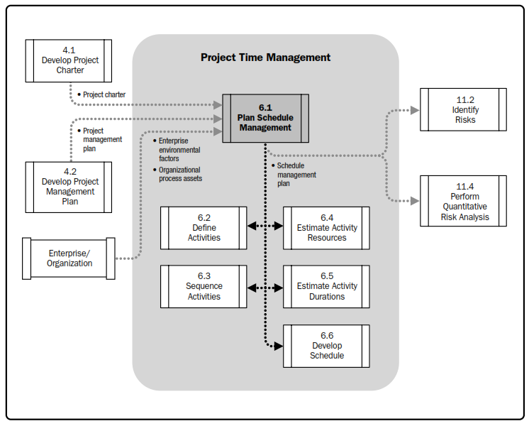
Plan Schedule Management

Slide 17
Plan Schedule Management
INPUTS
Project Management Plan
Project Charter
Enterprise Environmental Factors
Organizational Process Assets
Notes:
Topic 4.1.1
DEVELOP PROJECT CHARTER - INPUTS
4.1.1.1 Project Statement of Work
4.1.1.2 Business Case
4.1.1.3 Agreements
4.1.1.4 Enterprise Environmental Factors
4.1.1.4 Organizational Process Assets

Slide 18
Plan Schedule Management
INPUTS
Notes:
Topic 4.1.1
DEVELOP PROJECT CHARTER - INPUTS
4.1.1.1 Project Statement of Work
4.1.1.2 Business Case
4.1.1.3 Agreements
4.1.1.4 Enterprise Environmental Factors
4.1.1.4 Organizational Process Assets

Slide 19
Plan Schedule Management
INPUTS
Notes:
Topic 4.1.1
DEVELOP PROJECT CHARTER - INPUTS
4.1.1.1 Project Statement of Work
4.1.1.2 Business Case
4.1.1.3 Agreements
4.1.1.4 Enterprise Environmental Factors
4.1.1.4 Organizational Process Assets

Slide 20
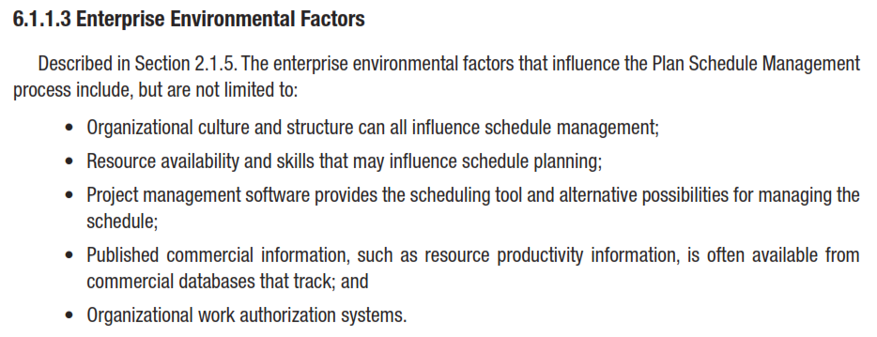
Plan Schedule Management
INPUTS
Notes:
Topic 4.1.1
DEVELOP PROJECT CHARTER - INPUTS
4.1.1.1 Project Statement of Work
4.1.1.2 Business Case
4.1.1.3 Agreements
4.1.1.4 Enterprise Environmental Factors
4.1.1.4 Organizational Process Assets

Slide 21
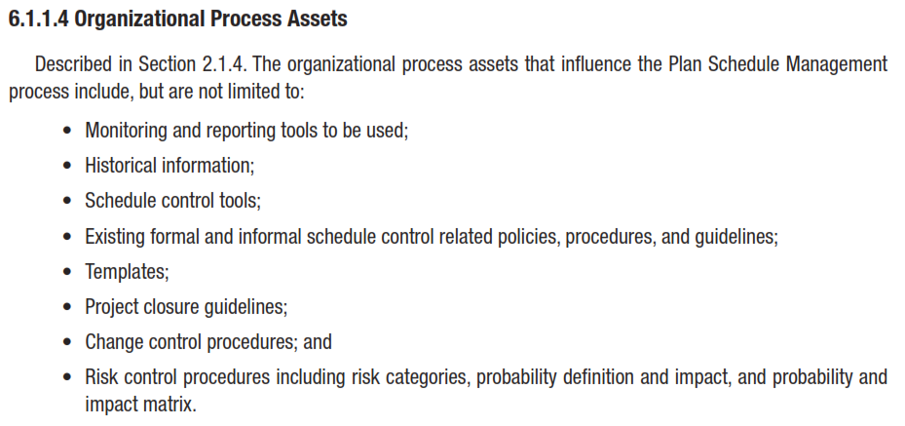
Plan Schedule Management
INPUTS
Notes:
Topic 4.1.1
DEVELOP PROJECT CHARTER - INPUTS
4.1.1.1 Project Statement of Work
4.1.1.2 Business Case
4.1.1.3 Agreements
4.1.1.4 Enterprise Environmental Factors
4.1.1.4 Organizational Process Assets

Slide 22
Plan Schedule Management
TOOLS & TECHNIQUES
Expert Judgment
Analytical Techniques
Meetings
Notes:
Topic 4.1.1
DEVELOP PROJECT CHARTER - INPUTS
4.1.1.1 Project Statement of Work
4.1.1.2 Business Case
4.1.1.3 Agreements
4.1.1.4 Enterprise Environmental Factors
4.1.1.4 Organizational Process Assets

Slide 23
Plan Schedule Management
TOOLS & TECHNIQUES
Notes:
Topic 4.1.1
DEVELOP PROJECT CHARTER - INPUTS
4.1.1.1 Project Statement of Work
4.1.1.2 Business Case
4.1.1.3 Agreements
4.1.1.4 Enterprise Environmental Factors
4.1.1.4 Organizational Process Assets

Slide 24
Plan Schedule Management
TOOLS & TECHNIQUES
Notes:
Topic 4.1.1
DEVELOP PROJECT CHARTER - INPUTS
4.1.1.1 Project Statement of Work
4.1.1.2 Business Case
4.1.1.3 Agreements
4.1.1.4 Enterprise Environmental Factors
4.1.1.4 Organizational Process Assets

Slide 25
ATs
Most widely used analytical methods / techniques include:
Brainstorming
Benchmarking
Gap Analysis
Pareto principle, Pareto principle 80-20 rule
Six Questions
SWOT Analysis
Cause and affect Diagram

Slide 26
Plan Schedule Management
TOOLS & TECHNIQUES
Notes:
Topic 4.1.1
DEVELOP PROJECT CHARTER - INPUTS
4.1.1.1 Project Statement of Work
4.1.1.2 Business Case
4.1.1.3 Agreements
4.1.1.4 Enterprise Environmental Factors
4.1.1.4 Organizational Process Assets

Slide 27
Plan Schedule Management
OUTPUTS
Notes:
Topic 4.1.1
DEVELOP PROJECT CHARTER - INPUTS
4.1.1.1 Project Statement of Work
4.1.1.2 Business Case
4.1.1.3 Agreements
4.1.1.4 Enterprise Environmental Factors
4.1.1.4 Organizational Process Assets

Slide 28
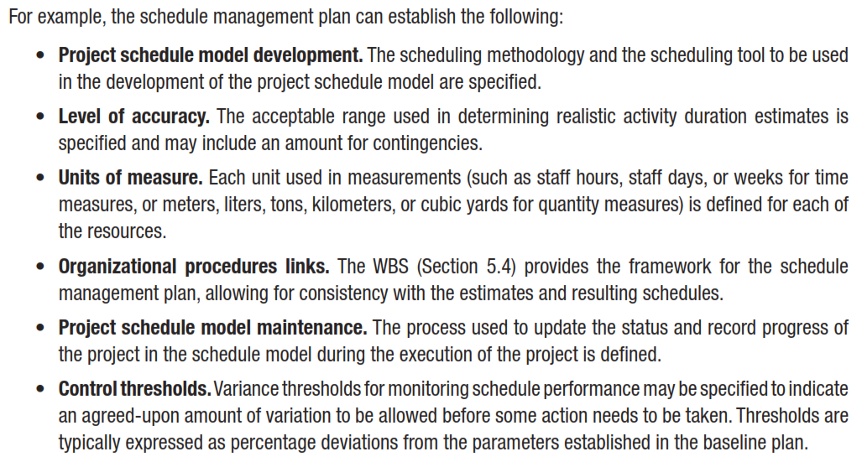
Plan Schedule Management
OUTPUTS
6.1.3.1 Schedule Management Plan
Notes:
Topic 4.1.1
DEVELOP PROJECT CHARTER - INPUTS
4.1.1.1 Project Statement of Work
4.1.1.2 Business Case
4.1.1.3 Agreements
4.1.1.4 Enterprise Environmental Factors
4.1.1.4 Organizational Process Assets

Slide 29
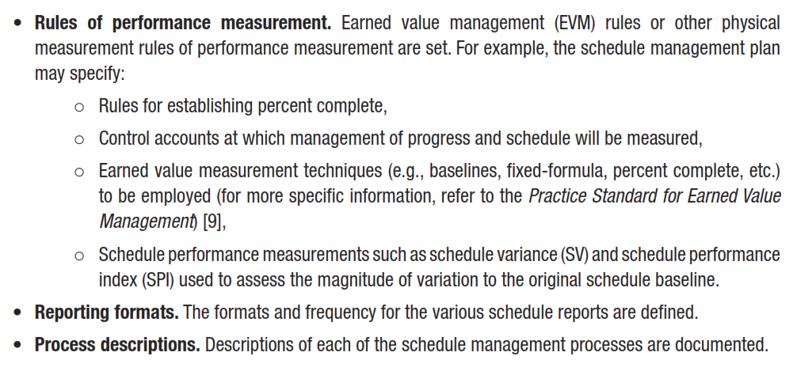
Plan Schedule Management
OUTPUTS
Notes:
Topic 4.1.1
DEVELOP PROJECT CHARTER - INPUTS
4.1.1.1 Project Statement of Work
4.1.1.2 Business Case
4.1.1.3 Agreements
4.1.1.4 Enterprise Environmental Factors
4.1.1.4 Organizational Process Assets

Slide 30
Break

Slide 31
DEFINE ACTIVITIES
Notes:
Chapter 4
PROJECT integration MANAGEMENT

Slide 32
Define Activities
Define Activities is the Process of identifying and documenting the specific actions to be performed to produce the project deliverables.
The key benefit of this process is to break work packages into activities that provide a basis for estimating, scheduling, executing, monitoring, and controlling the project work.
Notes:
Chapter 5
PROJECT SCOPE MANAGEMENT
SCOPE MANAGEMENT PLAN
Guidelines for how scope is to be managed and how scope changes are to be integrated into the project
It includes:
An assessment of the stability of the project scope
A clear description of how scope changes will be identified and classified

Slide 33
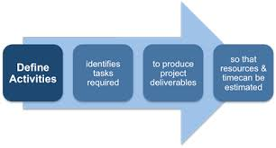
Define Activities

Slide 34
Define Activities
Inputs Tools & Techniques Outputs
Schedule Management Plan
Scope Baseline
Enterprise Environmental Factors
Organizational Process Assets
Decomposition
Rolling Wave Planning
Expert Judgment
Activity List
Activity Attributes
Milestone List

Slide 35
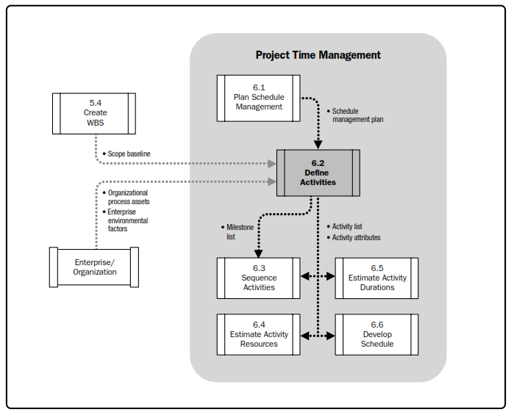
Define Activities

Slide 36
Define Activities
INPUTS
Schedule Management Plan
Scope Baseline
Enterprise Environmental Factors
Organizational Process Assets
Notes:
Topic 4.1.1
DEVELOP PROJECT CHARTER - INPUTS
4.1.1.1 Project Statement of Work
4.1.1.2 Business Case
4.1.1.3 Agreements
4.1.1.4 Enterprise Environmental Factors
4.1.1.4 Organizational Process Assets

Slide 37
Define Activities
INPUTS
Notes:
Topic 4.1.1
DEVELOP PROJECT CHARTER - INPUTS
4.1.1.1 Project Statement of Work
4.1.1.2 Business Case
4.1.1.3 Agreements
4.1.1.4 Enterprise Environmental Factors
4.1.1.4 Organizational Process Assets

Slide 38
Define Activities
INPUTS
Notes:
Topic 4.1.1
DEVELOP PROJECT CHARTER - INPUTS
4.1.1.1 Project Statement of Work
4.1.1.2 Business Case
4.1.1.3 Agreements
4.1.1.4 Enterprise Environmental Factors
4.1.1.4 Organizational Process Assets

Slide 39
Define Activities
INPUTS
Notes:
Topic 4.1.1
DEVELOP PROJECT CHARTER - INPUTS
4.1.1.1 Project Statement of Work
4.1.1.2 Business Case
4.1.1.3 Agreements
4.1.1.4 Enterprise Environmental Factors
4.1.1.4 Organizational Process Assets

Slide 40
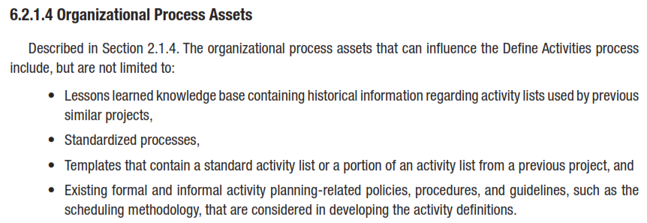
Define Activities
INPUTS
Notes:
Topic 4.1.1
DEVELOP PROJECT CHARTER - INPUTS
4.1.1.1 Project Statement of Work
4.1.1.2 Business Case
4.1.1.3 Agreements
4.1.1.4 Enterprise Environmental Factors
4.1.1.4 Organizational Process Assets

Slide 41
Define Activities
Tools & Techniques
Decomposition
Rolling Wave Planning
Expert Judgment
Notes:
Topic 4.1.1
DEVELOP PROJECT CHARTER - INPUTS
4.1.1.1 Project Statement of Work
4.1.1.2 Business Case
4.1.1.3 Agreements
4.1.1.4 Enterprise Environmental Factors
4.1.1.4 Organizational Process Assets

Slide 42
Define Activities
Tools & Techniques
Notes:
Topic 4.1.1
DEVELOP PROJECT CHARTER - INPUTS
4.1.1.1 Project Statement of Work
4.1.1.2 Business Case
4.1.1.3 Agreements
4.1.1.4 Enterprise Environmental Factors
4.1.1.4 Organizational Process Assets

Slide 43
Define Activities
Tools & Techniques
Notes:
Topic 4.1.1
DEVELOP PROJECT CHARTER - INPUTS
4.1.1.1 Project Statement of Work
4.1.1.2 Business Case
4.1.1.3 Agreements
4.1.1.4 Enterprise Environmental Factors
4.1.1.4 Organizational Process Assets

Slide 44
Define Activities
Tools & Techniques
Notes:
Topic 4.1.1
DEVELOP PROJECT CHARTER - INPUTS
4.1.1.1 Project Statement of Work
4.1.1.2 Business Case
4.1.1.3 Agreements
4.1.1.4 Enterprise Environmental Factors
4.1.1.4 Organizational Process Assets

Slide 45
Define Activities
Outputs
6.2.3.1 Activity List
6.2.3.2 Activity Attributes
6.2.3.3 Milestone List
Notes:
Topic 4.1.1
DEVELOP PROJECT CHARTER - INPUTS
4.1.1.1 Project Statement of Work
4.1.1.2 Business Case
4.1.1.3 Agreements
4.1.1.4 Enterprise Environmental Factors
4.1.1.4 Organizational Process Assets

Slide 46
Activity Lists and Attributes
An activity list is a tabulation of activities to be included on a project schedule. The list should include:
The activity name
An activity identifier or number
A brief description of the activity
Activity attributes provide more information about each activity, such as predecessors, successors, logical relationships, leads and lags, resource requirements, constraints, imposed dates, and assumptions related to the activity.

Slide 47
Activity list
1.14 Activities& Milestones
ID | Activities | Duration
1 | Officers Mess
1.1 | Planning
1.1.1 | Survey | 5 days
1.1.2 | Architect and Design | 5 days
1.1.3 | Planning Work Completed | 0 days
1.2 | Excavation
1.2.1 | Machine Excavation | 4 days
1.2.2 | Hand Tools Excavation | 4 days
1.2.3 | Excavation Completed | 0 days
1.3 | Foundation
1.3.1 | Reinforcement for Foundation | 10 days
1.3.2 | Concreting Foundation | 6 days
1.3.3 | Fill Around Foundation | 4 days
1.3.4 | Foundation work completed | 0 days
1.4 | Structure
1.4.1 | Ground Floor
1.4.1.1 | Reinforce Columns Ground Floor | 8 days
1.4.1.2 | Shuttering for Columns Ground Floor | 5 days
1.4.1.3 | Concreting for columns Ground Floor | 3 days
1.4.1.4 | Brickwork Ground Floor | 10 days
1.4.1.5 | Shuttring for Slab Ground Floor | 6 days
1.4.1.6 | Reinforce Slab Ground Floor | 4 days
1.4.1.7 | Concrete Slab Ground Floor | 3 days
1.4.1.8 | Ground Floor Completed | 0 days
1.6.2 | Tennis Court
1.6.2.1 | Leveling Surface | 3 days
1.6.2.2 | Stamping Grass | 5 days
1.6.2.3 | Installing Net | 1 day
1.6.2.4 | Installing Flood Lights | 2 days
1.6.2.5 | Tennis Court Completed | 0 days
1.7 | Officers Mess Completed | 0 days
Project: Mess Construction
Project ID: 003/2014

Slide 48
Milestones
A Milestone is a significant event that normally has no duration.
It often takes several activities and a lot of work to complete a milestone.
Milestones are useful tools for setting schedule goals and monitoring progress.
Examples include completion and customer sign-off on key documents and completion of specific products
High level milestones are given in project charter

Slide 49
SMART Criteria
Milestones should be:
Specific
Measurable
Assignable
Realistic
Time-framed

Slide 50
M/Ss
Milestones:
Site cleared and ready for construction 15 Jan 2014
Construction commence 16 Jan 2014
Foundation Excavation Completed 20 Feb 2014
Foundation set 15 Mar 2014
Building closed for weather 15 April 2014
All services (internal/external installed 31 May 2014
Kitchen/dining hall completed 31 June 2014
Landscaping completed 15 July 2014.
Handing over/Acceptance ceremony 20 August 2014
Project complete 01 September 2014

